Slide 1

Explainable AI for Breast Cancer Subtype Classification using RNA-Seq Data
By Boy Stroo, Niels Poldervaart, Quinn Rachman, Rick van Alphen & Wesley Zwaal
Group 3

Slide 2
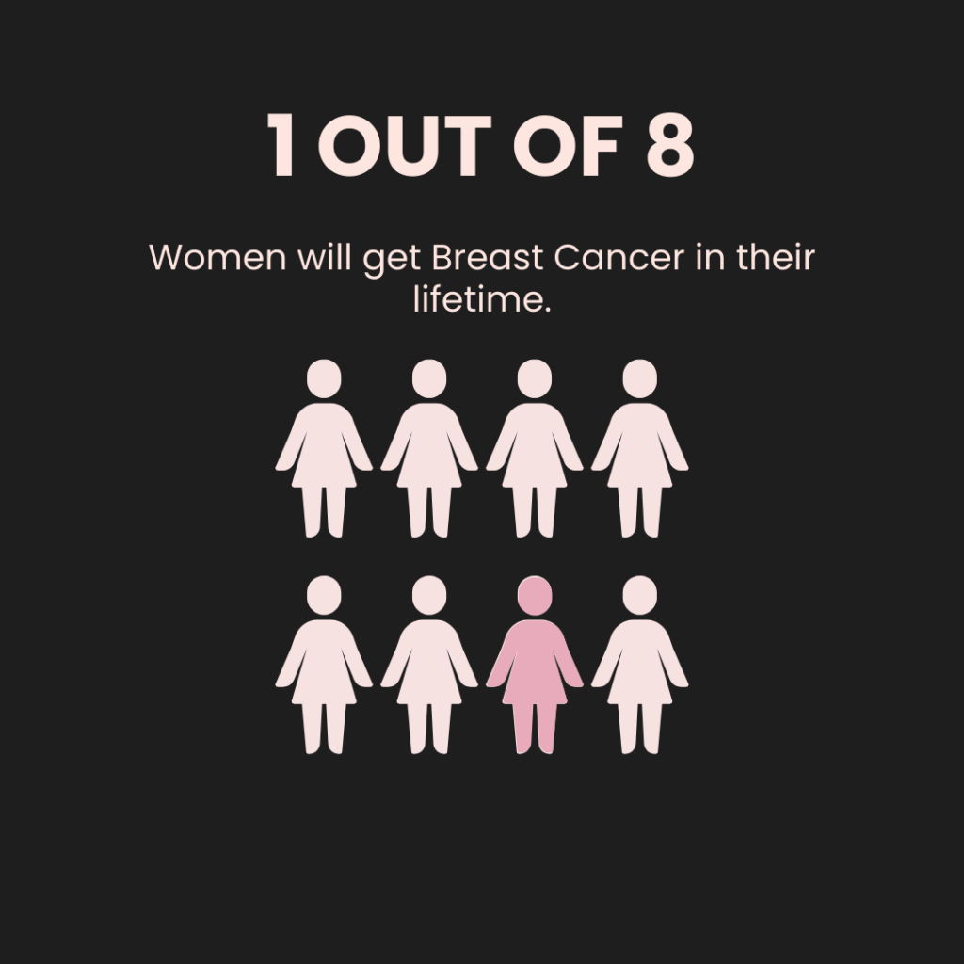
Breast Cancer
Most common cancer in women worldwide
Over 2 million new cases each year
Leading cause of cancer death for women
Breast cancer is not a single disease
Highly diverse and complex
Notes:
What is ALL?
ALL stands for Acute Lymphoblastic Leukemia (also called Acute Lymphocytic Leukemia). To understand this, let's break it down:
Leukemia is a type of blood cancer that starts in the bone marrow - the spongy tissue inside your bones where blood cells are made. Think of bone marrow as a factory that produces different types of blood cells your body needs to function.
Lymphoblastic refers to lymphoblasts, which are immature white blood cells called lymphocytes. In healthy people, these cells mature properly and help fight infections. In ALL, these cells get stuck in an immature state and can't do their job properly.
Acute means the disease develops and progresses quickly, unlike chronic leukemias that develop slowly over years.
So ALL is a cancer where the bone marrow produces too many immature, dysfunctional white blood cells that crowd out healthy blood cells. This leads to problems like increased infections (not enough working white blood cells), bleeding (not enough platelets), and fatigue (not enough red blood cells).
ALL vs B-ALL Comparison
ALL is actually divided into different subtypes based on which type of lymphocyte is affected:
B-ALL (B-cell ALL): This affects B-lymphocytes, which normally mature into plasma cells that produce antibodies to fight infections
T-ALL (T-cell ALL): This affects T-lymphocytes, which have different immune system functions
Key differences:
Frequency: B-ALL is much more common, making up about 85% of ALL cases
Age patterns: B-ALL is more common in young children (peak age 2-5 years), while T-ALL is more evenly distributed across age groups
Prognosis: B-ALL generally has better treatment outcomes, especially in children
Treatment approach: While both use similar chemotherapy protocols, the specific drug combinations and timing may vary
The important takeaway is that B-ALL is essentially the most common form of ALL, and when people talk about childhood leukemia, they're usually referring to B-ALL specifically.

Slide 3
Our goal
Develop an Explainable AI to classify subtypes in breast cancer
Key goal to make explainable predictions
Helps clinicians make informed decisions
Patients get specialized treatment for specific subtype
Notes:
NIELS
Our aim for this project was to create an Explainable AI to help classify B-ALL from a ALL patient with the help of RNA-Seq data, whilst also giving the predictions that are interpretable which is critical for clinician confidence and biological validation.
Our solution will address a gap in the research field, with the key goal to make accurate and understandable predictions. Which helps the clinicians make faster, more informed decisions. Which in turn helps the patients get earlier and more specified treatment

Slide 4
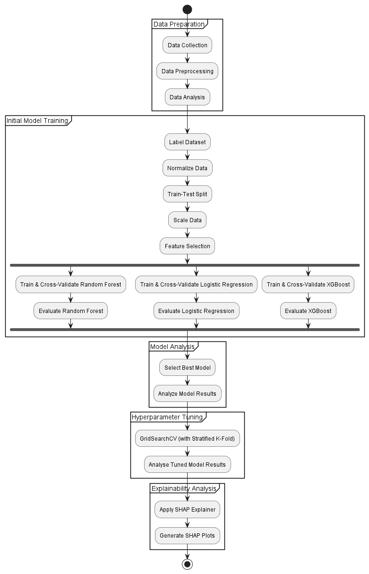
Workflow Pipeline
Notes:
NIELS

Slide 5
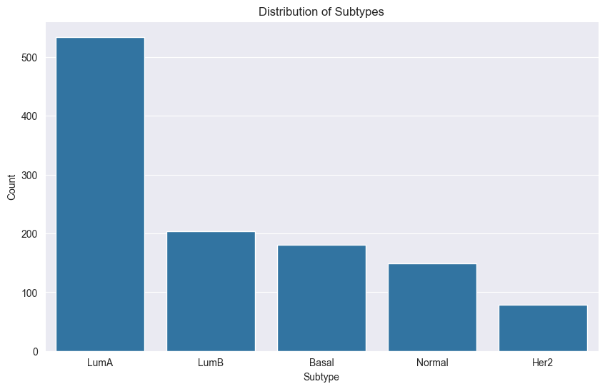
Dataset
TCGA-BRCA dataset from GDC
RNA-Seq data
1215 total samples
Five breast cancer subtypes
Notes:
NIELS

Slide 6
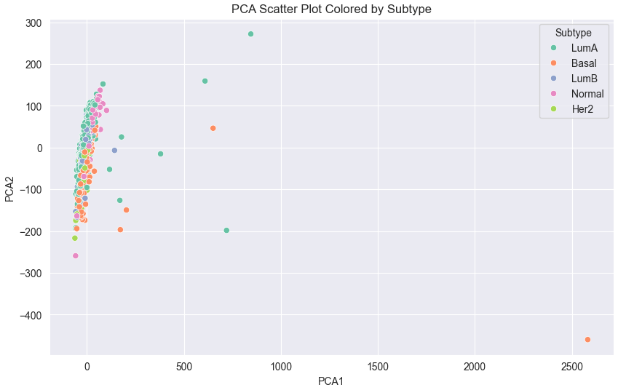
Preprocessing
Cross reference genes and subtypes
Remove NaN values
Apply Log2 transformation to normalize values
Notes:
QUINN

Slide 7
Feature Selection Strategies
Recursive Feature Elimination (RFE) using Logistic Regression
Select From Model (SFM) using Random Forest
Select K Best (SKB)
Wrapper method
Iteratively trains a model and removes the weakest features
Pros: Thorough, finds features that work well together Cons: Very slow, can overfit to the model
Embedded method
Train model once and select features based on internal importance score
Pros: Balanced speed and Performance, capture feature interaction
Cons: Features biased towards the used model
Univariate filter
Use statistical tests (ANOVA F-test) to score each feature independently
Pros: Extremely Fast
Cons: Ignores feature interaction
Notes:
QUINN

Slide 8
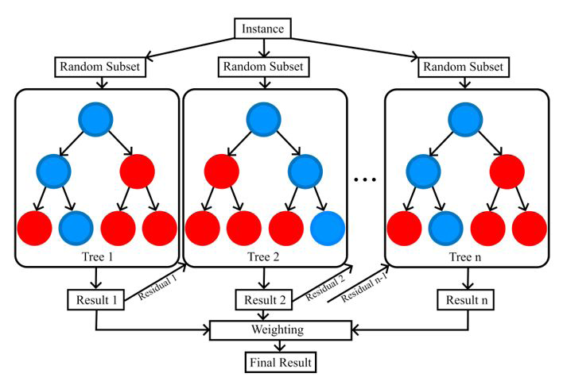
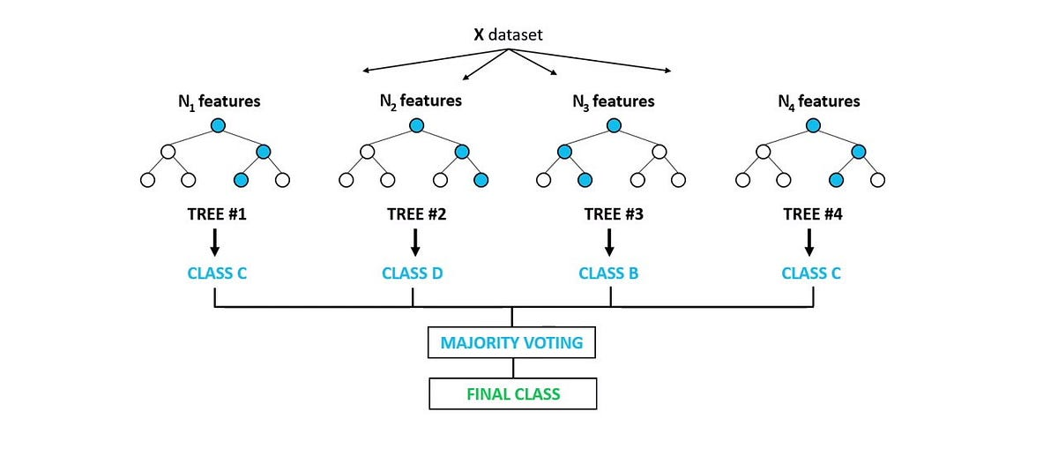
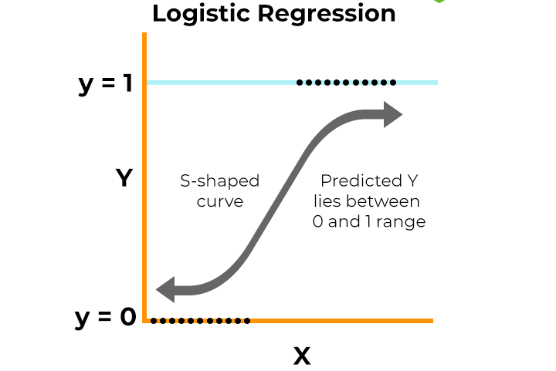
Models
Random Forest
Multiple decision trees from random data subsets
Ranks feature importance (ideal for identifying informative genes)
Effective at handling high-dimensional data
Robust to noise
XGBoost
Sequential trees where each new tree corrects errors made by previous ones
Strong feature importance ranking
Effective at handling high-dimensional data
Robust to noise
Logistic Regression
Models the probability of an outcome by fitting data to a linear boundary
Fast, stable and highly interpretable model for classification
Can be used for multiclass classification (One-vs-Rest)
Notes:
QUINN

Slide 9
Model Training
GridsearchCV
Pipeline function
Scaling
Constant Variance Filtering
Stratified K Fold for Cross Validation
k=5
Cross validated scores
Model with the lowest overfitting gap is selected
Brute force try every single combination defined in the grid
Therefore it’s computationally intensive to run
Less smart than other alternatives like RandomizedSearchCV and Bayesian Optimization
Thoroughness over speed prioritized
Notes:
QUINN

Slide 10
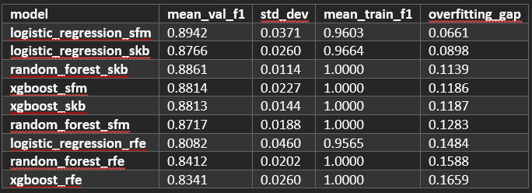
Results
Notes:
QUINN

Slide 11
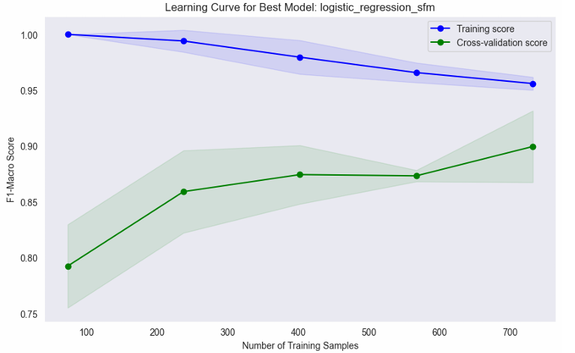
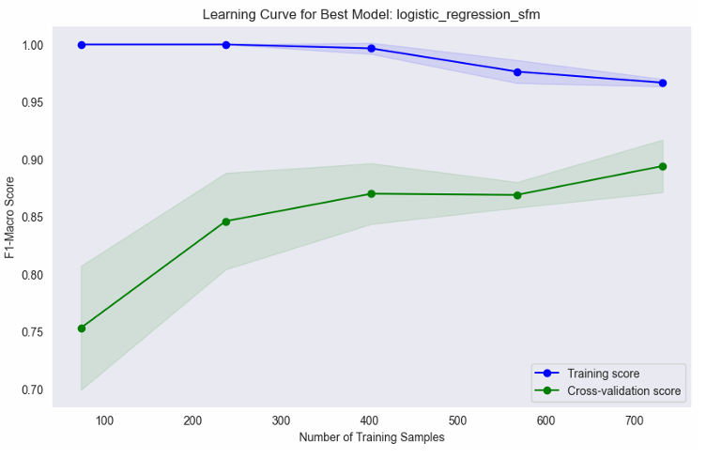
Notes:
QUINN

Slide 12
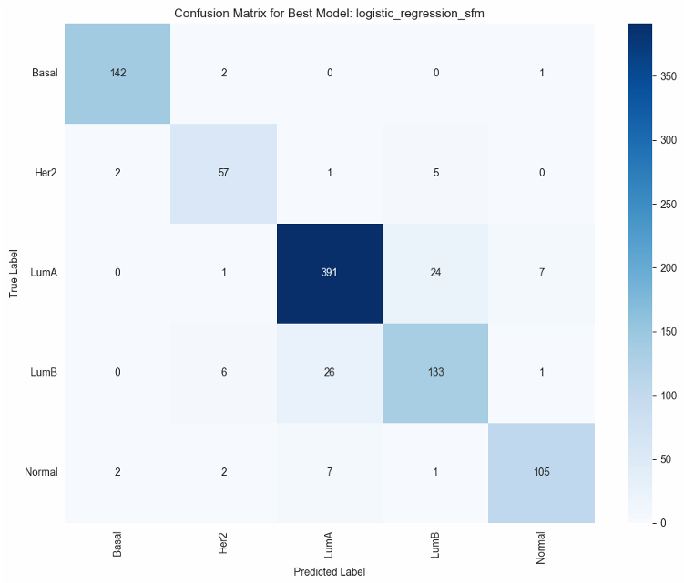
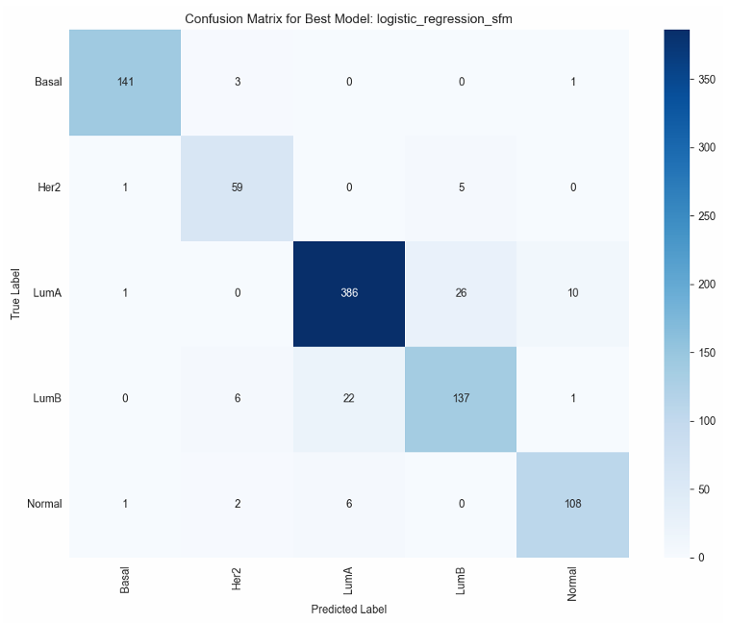
Notes:
QUINN

Slide 13
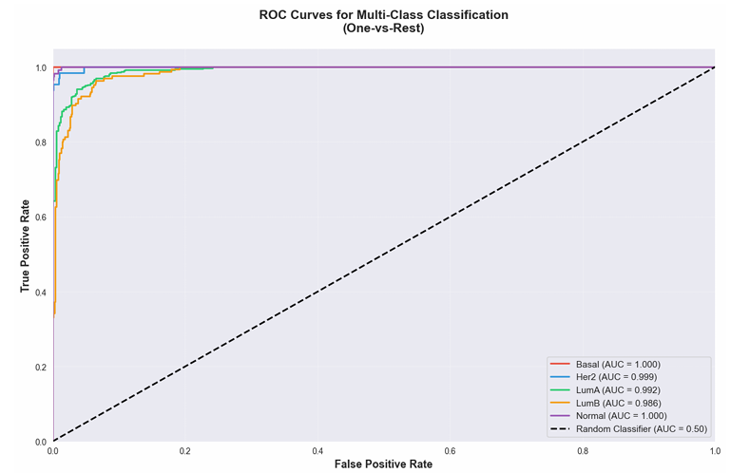
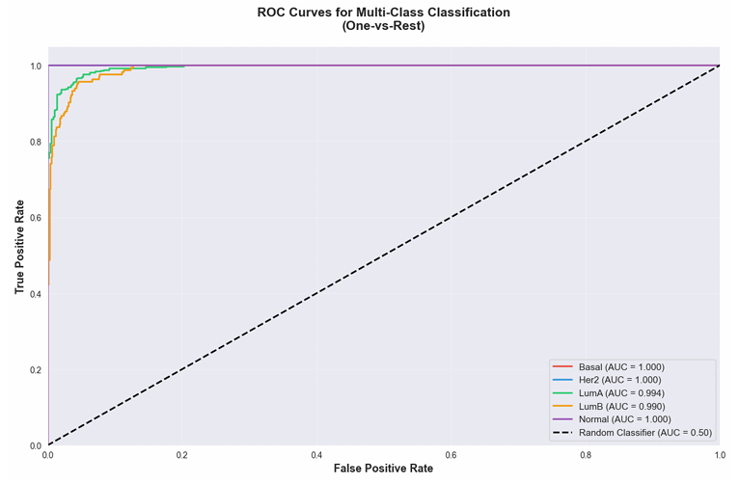
Notes:
BOY

Slide 14
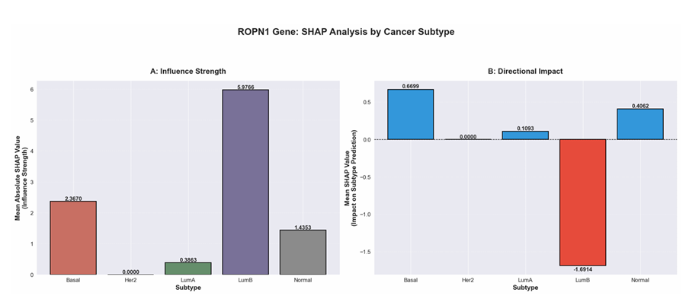
SHapley Additive exPlanations (SHAP) Result
Notes:
BOY

Slide 15
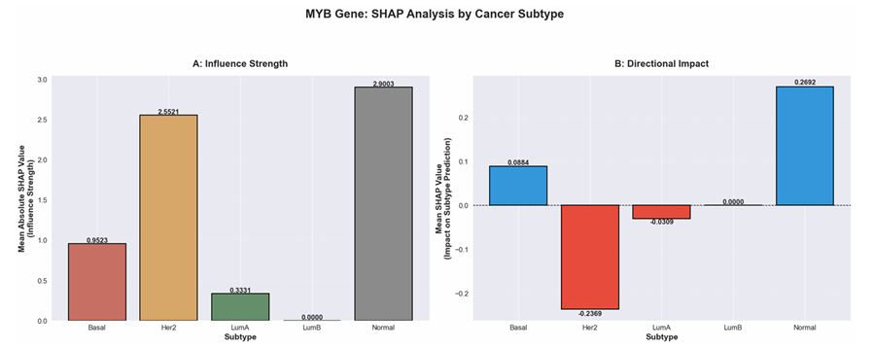
SHapley Additive exPlanations (SHAP) Result
Notes:
BOY

Slide 16
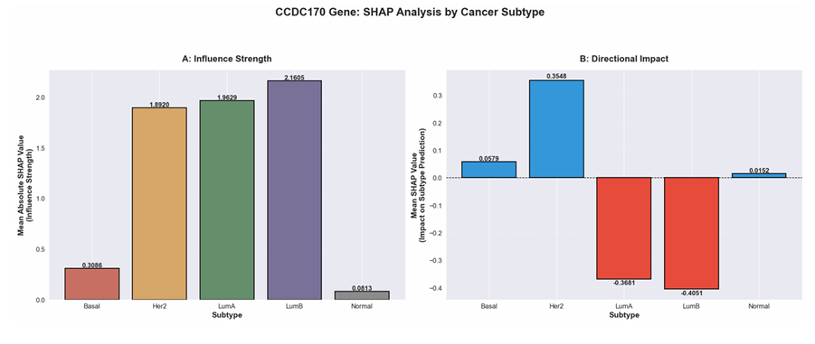
SHapley Additive exPlanations (SHAP) Result
Notes:
BOY

Slide 17

Future work
External Validation
Validate it on other datasets
Exploration with Non-Linearity
Explore these findings and apply SHAP to non-linear models
Notes:
BOY

Slide 18
The End
Are there any questions?

